Slide 1



CST 347 – Real Time OS
Lecture 19 – File Systems I
Troy Scevers

Slide 2
Topics
Overview of Mass Storage Structure
Disk Structure
Disk Attachment
Disk Scheduling
Disk Management
Swap-Space Management
RAID Structure
Stable-Storage Implementation
Tertiary Storage Devices
Notes:
Objectives of chapter
Describe the physical structure of secondary and tertiary storage devices and the resulting effects on the uses of the devices
Explain the performance characteristics of mass-storage devices
Discuss operating-system services provided for mass storage, including RAID and HSM

Slide 3
Overview of Mass Storage Structure
Magnetic disks provide bulk of secondary storage of modern computers
  Drives rotate at 60 to 250 times per second
  Transfer rate is rate at which data flow between drive and computer
  Positioning time (random-access time) is time to move disk arm to desired cylinder (seek time) and time for desired sector to rotate under the disk head (rotational latency)
  Head crash results from disk head making contact with the disk surface
    That’s bad
Disks can be removable
Drive attached to computer via I/O bus
  Busses vary, including EIDE, ATA, SATA, USB, Fibre Channel, SCSI, SAS, Firewire
  Host controller in computer uses bus to talk to disk controller built into drive or storage array

Slide 4

Magnetic Disks
Platters range from .85” to 14” (historically)
  Commonly 3.5”, 2.5”, and 1.8”
Range from 30GB to 3TB per drive
Performance
  Transfer Rate – theoretical – 6 Gb/sec
  Effective Transfer Rate – real – 1Gb/sec
  Seek time from 3ms to 12ms – 9ms common for desktop drives
  Average seek time measured or calculated based on 1/3 of tracks
  Latency based on spindle speed
    1/(RPM * 60)
  Average latency = ½ latency
(From Wikipedia)
(From Wikipedia)
(From Wikipedia)
(From Wikipedia)

Slide 5
Magnetic Disk Performance
Access Latency = Average access time = average seek time + average latency
  For fastest disk 3ms + 2ms = 5ms
  For slow disk 9ms + 5.56ms = 14.56ms
Average I/O time = average access time + (amount to transfer / transfer rate) + controller overhead
For example to transfer a 4KB block on a 7200 RPM disk with a 5ms average seek time, 1Gb/sec transfer rate with a .1ms controller overhead =
  5ms + 4.17ms + 4KB / 1Gb/sec + 0.1ms =
  9.27ms + 4 / 131072 sec =
  9.27ms + .12ms = 9.39ms

Slide 6
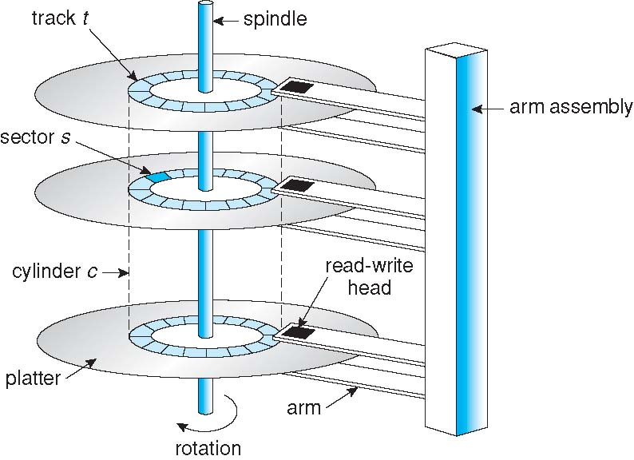
Moving-head Disk Mechanism

Slide 7

The First Commercial Disk Drive
1956
IBM RAMDAC computer included the IBM Model 350 disk storage system
  5M (7 bit) characters
  50 x 24” platters
  Access time = < 1 second

Slide 8
Solid-State Disks
Nonvolatile memory used like a hard drive
  Many technology variations
Can be more reliable than HDDs
More expensive per MB
Maybe have shorter life span
Less capacity
But much faster
Busses can be too slow -> connect directly to PCI for example
No moving parts, so no seek time or rotational latency

Slide 9
Magnetic Tape
Was early secondary-storage medium
  Evolved from open spools to cartridges
Relatively permanent and holds large quantities of data
Access time slow
Random access ~1000 times slower than disk
Mainly used for backup, storage of infrequently-used data, transfer medium between systems
Kept in spool and wound or rewound past read-write head
Once data under head, transfer rates comparable to disk
  140MB/sec and greater
200GB to 1.5TB typical storage
Common technologies are LTO-{3,4,5} and T10000

Slide 10
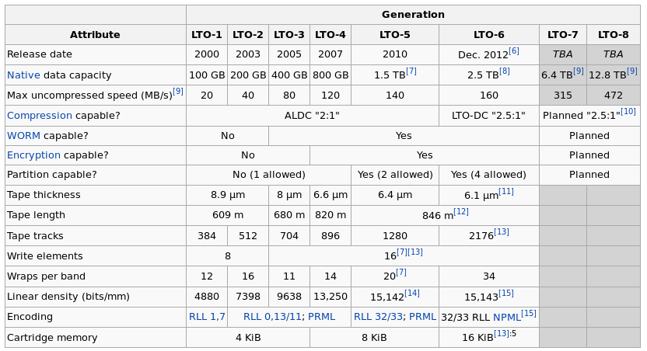
LTO Tape Capactities
(From Wikipedia)

Slide 11
Disk Structure
Disk drives are addressed as large 1-dimensional arrays of logical blocks, where the logical block is the smallest unit of transfer
The 1-dimensional array of logical blocks is mapped into the sectors of the disk sequentially
  Sector 0 is the first sector of the first track on the outermost cylinder
  Mapping proceeds in order through that track, then the rest of the tracks in that cylinder, and then through the rest of the cylinders from outermost to innermost
  Logical to physical address should be easy
    Except for bad sectors
    Non-constant # of sectors per track via constant angular velocity

Slide 12
Disk Attachment
Host-attached storage accessed through I/O ports talking to I/O busses
SCSI itself is a bus, up to 16 devices on one cable, SCSI initiator requests operation and SCSI targets perform tasks
  Each target can have up to 8 logical units (disks attached to device controller)
FC is high-speed serial architecture
  Can be switched fabric with 24-bit address space – the basis of storage area networks (SANs) in which many hosts attach to many storage units
I/O directed to bus ID, device ID, logical unit (LUN)
Notes:
What are some other BUS Types?
IDE or ATA
SATA
USB
Firewire
Thunderbolt

Slide 13
Storage Array
Can just attach disks, or arrays of disks
Storage Array has controller(s), provides features to attached host(s)
  Ports to connect hosts to array
  Memory, controlling software (sometimes NVRAM, etc)
  A few to thousands of disks
  RAID, hot spares, hot swap (discussed later)
  Shared storage -> more efficiency
  Features found in some file systems
    Snaphots, clones, thin provisioning, replication, deduplication, etc

Slide 14
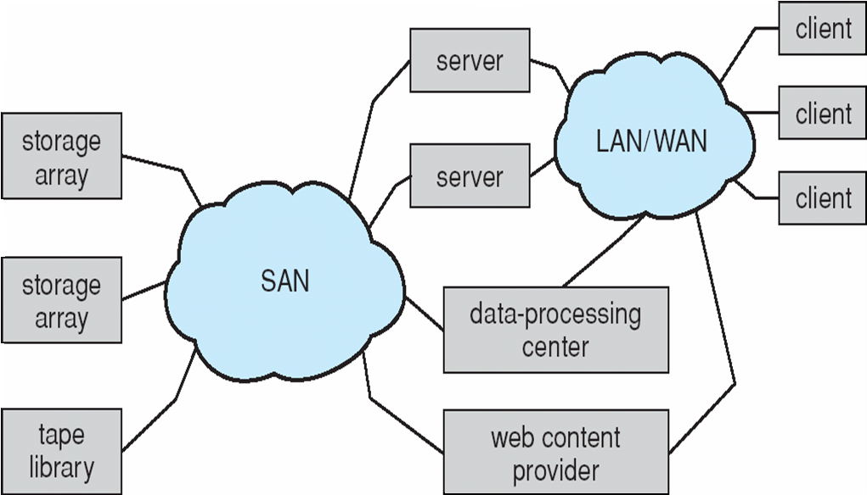
Storage Area Network
Common in large storage environments
Multiple hosts attached to multiple storage arrays - flexible

Slide 15
Storage Area Network (Cont.)
SAN is one or more storage arrays
  Connected to one or more Fibre Channel switches
Hosts also attach to the switches
Storage made available via LUN Masking from specific arrays to specific servers
Easy to add or remove storage, add new host and allocate it storage
  Over low-latency Fibre Channel fabric
Why have separate storage networks and communications networks?
  Consider iSCSI, FCOE
Notes:
ISCSI – Network Attached storage protocol
FCOE - Fibre Channel over Ethernet

Slide 16

Network-Attached Storage
Network-attached storage (NAS) is storage made available over a network rather than over a local connection (such as a bus)
  Remotely attaching to file systems
NFS and CIFS are common protocols
Implemented via remote procedure calls (RPCs) between host and storage over typically TCP or UDP on IP network
iSCSI protocol uses IP network to carry the SCSI protocol
  Remotely attaching to devices (blocks)

Slide 17
Disk Scheduling
The operating system is responsible for using hardware efficiently — for the disk drives, this means having a fast access time and disk bandwidth
Minimize seek time
Seek time ≈ seek distance
Disk bandwidth is the total number of bytes transferred, divided by the total time between the first request for service and the completion of the last transfer

Slide 18
Disk Scheduling (Cont.)
There are many sources of disk I/O request
  OS
  System processes
  Users processes
I/O request includes input or output mode, disk address, memory address, number of sectors to transfer
OS maintains queue of requests, per disk or device
Idle disk can immediately work on I/O request, busy disk means work must queue
  Optimization algorithms only make sense when a queue exists
Note that drive controllers have small buffers and can manage a queue of I/O requests (of varying “depth”)
Several algorithms exist to schedule the servicing of disk I/O requests
The analysis is true for one or many platters
We illustrate scheduling algorithms with a request queue (0-199)
98, 183, 37, 122, 14, 124, 65, 67
Head pointer 53

Slide 19

FCFS
Illustration shows total head movement of 640 cylinders
Notes:
Simplest form of disk scheduling.
First-Come, First-Served
Intrinsically fair, But does not generally provide the fastest service
Wild swing from 122 to 14 and then from 14 to 124 illustrates the problem... If requests for cylander 37 and 14 could be serviced before or after 122 and 124, total head movement would be decreased substantially.

Slide 20
STTF
Shortest Seek Time First selects the request with the minimum seek time from the current head position
SSTF scheduling is a form of SJF scheduling; may cause starvation of some requests
Illustration shows total head movement of 236 cylinders
Notes:
Shortest Job First – SJF

Slide 21

SSTF (Cont.)
Notes:
Suppose we have two resquests in queue for 14 and 186. While 14 is being processed antoher request for 14 comes along. While this one happens another one comes along... etc...
This scenario becomes more likely as pending-request queues grow.
While an substantial improvement, algorithm is not optimal. In the example we could do better by moving head from 53 to 37, even the latter is not closest, and then to 14, before turning around to service 65, 67, 98, 122, 124, and 183...
Would reduce total head movement to 208

Slide 22
SCAN
The disk arm starts at one end of the disk, and moves toward the other end, servicing requests until it gets to the other end of the disk, where the head movement is reversed and servicing continues.
SCAN algorithm Sometimes called the elevator algorithm
Illustration shows total head movement of 208 cylinders
But note that if requests are uniformly dense, largest density at other end of disk and those wait the longest

Slide 23

SCAN (Cont.)

Slide 24
C-SCAN
Provides a more uniform wait time than SCAN
The head moves from one end of the disk to the other, servicing requests as it goes
  When it reaches the other end, however, it immediately returns to the beginning of the disk, without servicing any requests on the return trip
Treats the cylinders as a circular list that wraps around from the last cylinder to the first one
Total number of cylinders?

Slide 25

C-SCAN (Cont.)

Slide 26
C-LOOK
LOOK a version of SCAN, C-LOOK a version of C-SCAN
Arm only goes as far as the last request in each direction, then reverses direction immediately, without first going all the way to the end of the disk
Total number of cylinders?

Slide 27

C-LOOK (Cont.)

Slide 28
Selecting a Disk-Scheduling Algorithm
SSTF is common and has a natural appeal
SCAN and C-SCAN perform better for systems that place a heavy load on the disk
  Less starvation
Performance depends on the number and types of requests
Requests for disk service can be influenced by the file-allocation method
  And metadata layout
The disk-scheduling algorithm should be written as a separate module of the operating system, allowing it to be replaced with a different algorithm if necessary
Either SSTF or LOOK is a reasonable choice for the default algorithm
What about rotational latency?
  Difficult for OS to calculate
How does disk-based queuing effect OS queue ordering efforts?

Slide 29
Disk Management
Low-level formatting, or physical formatting — Dividing a disk into sectors that the disk controller can read and write
  Each sector can hold header information, plus data, plus error correction code (ECC)
  Usually 512 bytes of data but can be selectable
To use a disk to hold files, the operating system still needs to record its own data structures on the disk
  Partition the disk into one or more groups of cylinders, each treated as a logical disk
  Logical formatting or “making a file system”
  To increase efficiency most file systems group blocks into clusters
    Disk I/O done in blocks
    File I/O done in clusters
Boot block initializes system
  The bootstrap is stored in ROM
  Bootstrap loader program stored in boot blocks of boot partition
Methods such as sector sparing used to handle bad blocks

Slide 30

Booting from a Disk in Windows 2000

Slide 31
Swap-Space Management
Swap-space — Virtual memory uses disk space as an extension of main memory
  Less common now due to memory capacity increases
Swap-space can be carved out of the normal file system, or, more commonly, it can be in a separate disk partition (raw)
Swap-space management
  4.3BSD allocates swap space when process starts; holds text segment (the program) and data segment
  Kernel uses swap maps to track swap-space use
  Solaris 2 allocates swap space only when a dirty page is forced out of physical memory, not when the virtual memory page is first created
    File data written to swap space until write to file system requested
    Other dirty pages go to swap space due to no other home
    Text segment pages thrown out and reread from the file system as needed
What if a system runs out of swap space?
Some systems allow multiple swap spaces

Slide 32
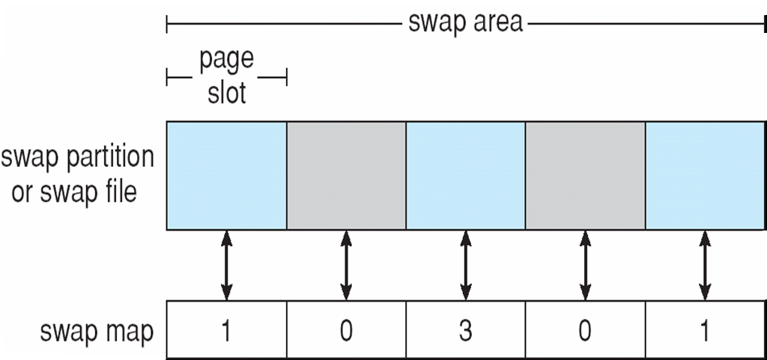
Data Structures for Swapping on Linux Systems

Slide 33
RAID Structure
RAID – multiple disk drives provides reliability via redundancy
Increases the mean time to failure
Frequently combined with NVRAM to improve write performance
RAID is arranged into six different levels

Slide 34
RAID (Cont.)
Several improvements in disk-use techniques involve the use of multiple disks working cooperatively
Disk striping uses a group of disks as one storage unit
RAID schemes improve performance and improve the reliability of the storage system by storing redundant data
  Mirroring or shadowing (RAID 1) keeps duplicate of each disk
  Striped mirrors (RAID 1+0) or mirrored stripes (RAID 0+1) provides high performance and high reliability
  Block interleaved parity (RAID 4, 5, 6) uses much less redundancy
RAID within a storage array can still fail if the array fails, so automatic replication of the data between arrays is common
Frequently, a small number of hot-spare disks are left unallocated, automatically replacing a failed disk and having data rebuilt onto them

Slide 35
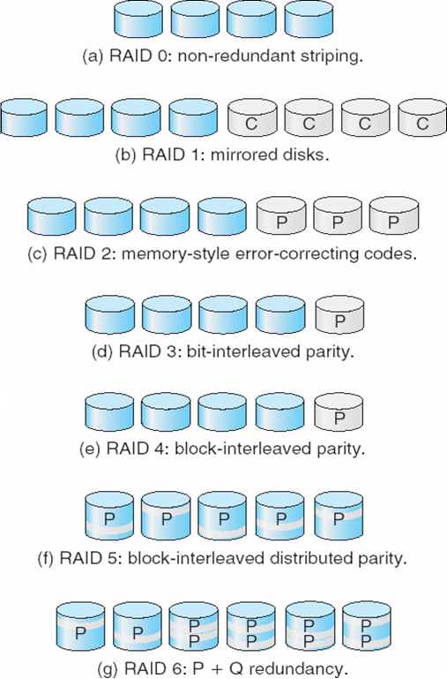
RAID Levels

Slide 36
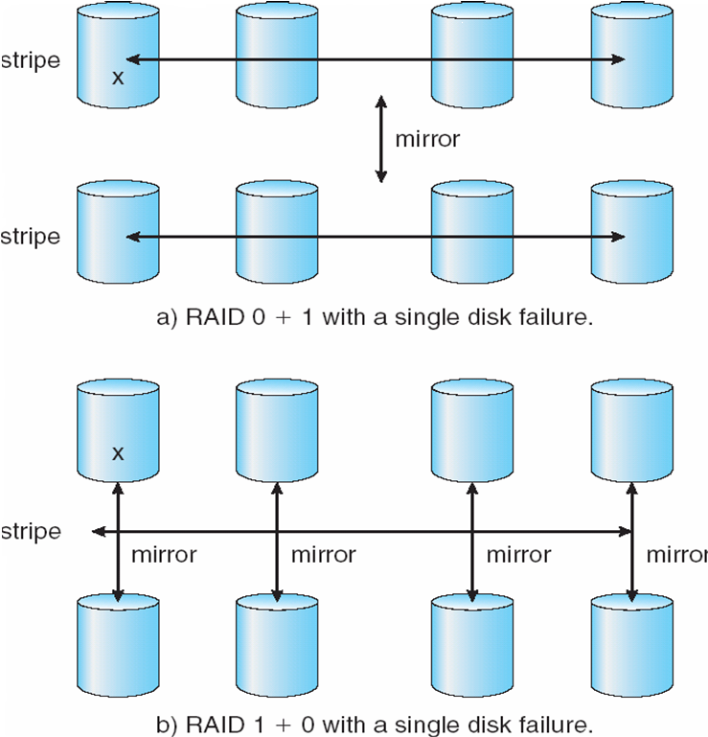
RAID (0 + 1) and (1 + 0)

Slide 37
Extensions
RAID alone does not prevent or detect data corruption or other errors, just disk failures
Solaris ZFS adds checksums of all data and metadata
Checksums kept with pointer to object, to detect if object is the right one and whether it changed
Can detect and correct data and metadata corruption
ZFS also removes volumes, partititions
  Disks allocated in pools
  Filesystems with a pool share that pool, use and release space like “malloc” and “free” memory allocate / release calls

Slide 38
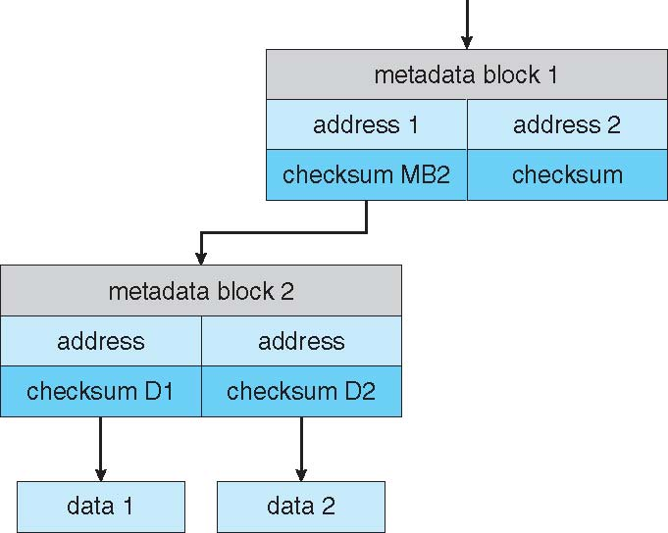
ZFS Checksums All Metadata and Data

Slide 39
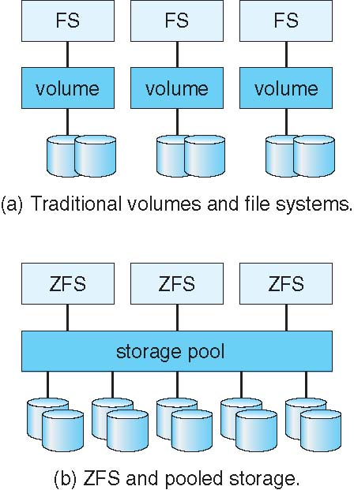
Traditional and Pooled Storage

Slide 40
Stable-Storage Implementation
Write-ahead log scheme requires stable storage
To implement stable storage:
  Replicate information on more than one nonvolatile storage media with independent failure modes
  Update information in a controlled manner to ensure that we can recover the stable data after any failure during data transfer or recovery

Slide 41
Tertiary Storage Devices
Low cost is the defining characteristic of tertiary storage
Generally, tertiary storage is built using removable media
Common examples of removable media are floppy disks and CD-ROMs; other types are available

Slide 42
Removable Disks
Floppy disk — thin flexible disk coated with magnetic material, enclosed in a protective plastic case
  Most floppies hold about 1 MB; similar technology is used for removable disks that hold more than 1 GB
  Removable magnetic disks can be nearly as fast as hard disks, but they are at a greater risk of damage from exposure

Slide 43
Removable Disks (Cont.)
A magneto-optic disk records data on a rigid platter coated with magnetic material
  Laser heat is used to amplify a large, weak magnetic field to record a bit
  Laser light is also used to read data (Kerr effect)
  The magneto-optic head flies much farther from the disk surface than a magnetic disk head, and the magnetic material is covered with a protective layer of plastic or glass; resistant to head crashes
Optical disks do not use magnetism; they employ special materials that are altered by laser light

Slide 44
WORM Disks
The data on read-write disks can be modified over and over
WORM (“Write Once, Read Many Times”) disks can be written only once
Thin aluminum film sandwiched between two glass or plastic platters
To write a bit, the drive uses a laser light to burn a small hole through the aluminum; information can be destroyed by not altered
Very durable and reliable
Read-only disks, such ad CD-ROM and DVD, com from the factory with the data pre-recorded

Slide 45
Tapes
Compared to a disk, a tape is less expensive and holds more data, but random access is much slower.
Tape is an economical medium for purposes that do not require fast random access, e.g., backup copies of disk data, holding huge volumes of data.
Large tape installations typically use robotic tape changers that move tapes between tape drives and storage slots in a tape library
  stacker – library that holds a few tapes
  silo – library that holds thousands of tapes
A disk-resident file can be archived to tape for low cost storage; the computer can stage it back into disk storage for active use.

Slide 46
Operating System Support
Major OS jobs are to manage physical devices and to present a virtual machine abstraction to applications
For hard disks, the OS provides two abstraction:
  Raw device – an array of data blocks
  File system – the OS queues and schedules the interleaved requests from several applications

Slide 47
Application Interface
Most OSs handle removable disks almost exactly like fixed disks — a new cartridge is formatted and an empty file system is generated on the disk
Tapes are presented as a raw storage medium, i.e., and application does not not open a file on the tape, it opens the whole tape drive as a raw device
Usually the tape drive is reserved for the exclusive use of that application
Since the OS does not provide file system services, the application must decide how to use the array of blocks
Since every application makes up its own rules for how to organize a tape, a tape full of data can generally only be used by the program that created it

Slide 48
Tape Drives
The basic operations for a tape drive differ from those of a disk drive
locate()positions the tape to a specific logical block, not an entire track (corresponds to seek())
The read position()operation returns the logical block number where the tape head is
The space()operation enables relative motion
Tape drives are “append-only” devices; updating a block in the middle of the tape also effectively erases everything beyond that block
An EOT mark is placed after a block that is written

Slide 49
File Naming
The issue of naming files on removable media is especially difficult when we want to write data on a removable cartridge on one computer, and then use the cartridge in another computer.
Contemporary OSs generally leave the name space problem unsolved for removable media, and depend on applications and users to figure out how to access and interpret the data.
Some kinds of removable media (e.g., CDs) are so well standardized that all computers use them the same way.

Slide 50
Hierarchical Storage Management (HSM)
A hierarchical storage system extends the storage hierarchy beyond primary memory and secondary storage to incorporate tertiary storage — usually implemented as a jukebox of tapes or removable disks.
Usually incorporate tertiary storage by extending the file system
  Small and frequently used files remain on disk
  Large, old, inactive files are archived to the jukebox
HSM is usually found in supercomputing centers and other large installations that have enormous volumes of data.

Slide 51
Speed
Two aspects of speed in tertiary storage are bandwidth and latency.
Bandwidth is measured in bytes per second.
  Sustained bandwidth – average data rate during a large transfer; # of bytes/transfer time
  Data rate when the data stream is actually flowing
  Effective bandwidth – average over the entire I/O time, including seek() or locate(), and cartridge switching
  Drive’s overall data rate

Slide 52
Reliability
A fixed disk drive is likely to be more reliable than a removable disk or tape drive
An optical cartridge is likely to be more reliable than a magnetic disk or tape
A head crash in a fixed hard disk generally destroys the data, whereas the failure of a tape drive or optical disk drive often leaves the data cartridge unharmed

Slide 53
Cost
Main memory is much more expensive than disk storage
The cost per megabyte of hard disk storage is competitive with magnetic tape if only one tape is used per drive
The cheapest tape drives and the cheapest disk drives have had about the same storage capacity over the years
Tertiary storage gives a cost savings only when the number of cartridges is considerably larger than the number of drives

Slide 54
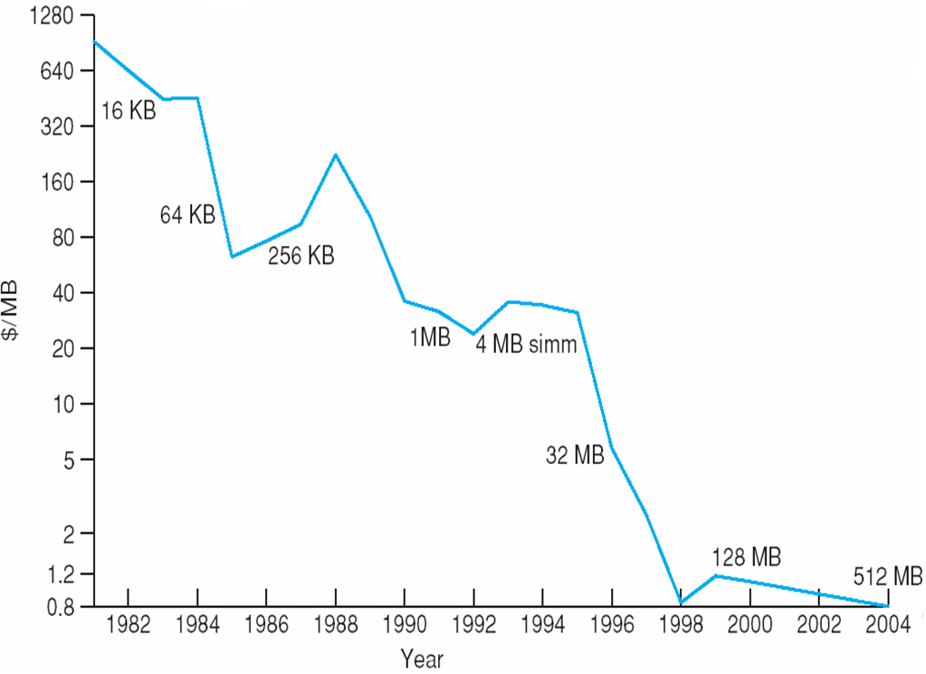
Price per Megabyte of DRAM From 1981 to 2004

Slide 55
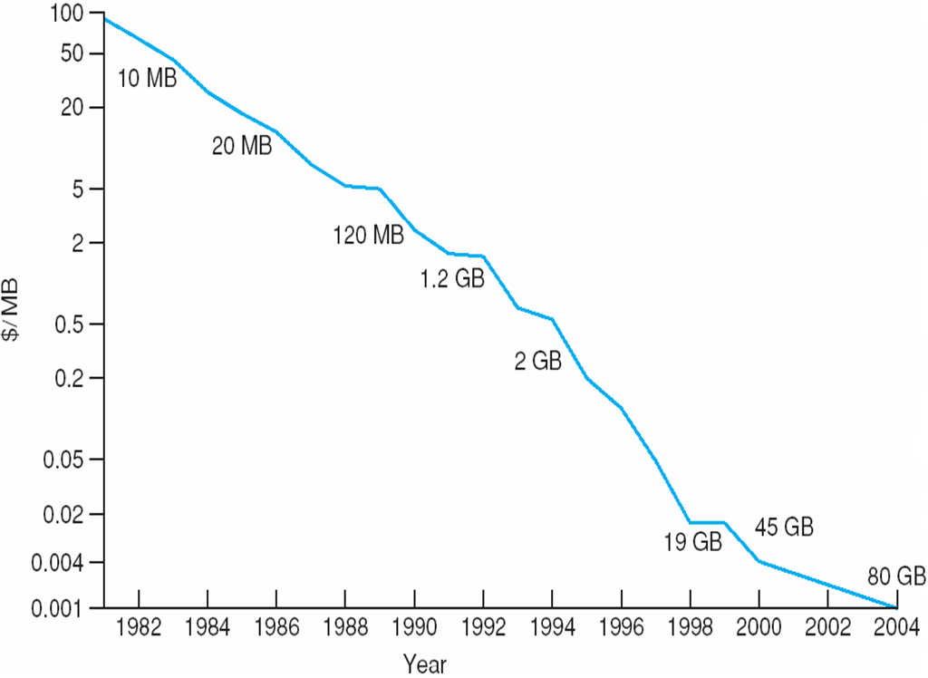
Price per Megabyte of Magnetic Hard Disk From 1981 to 2004

Slide 56
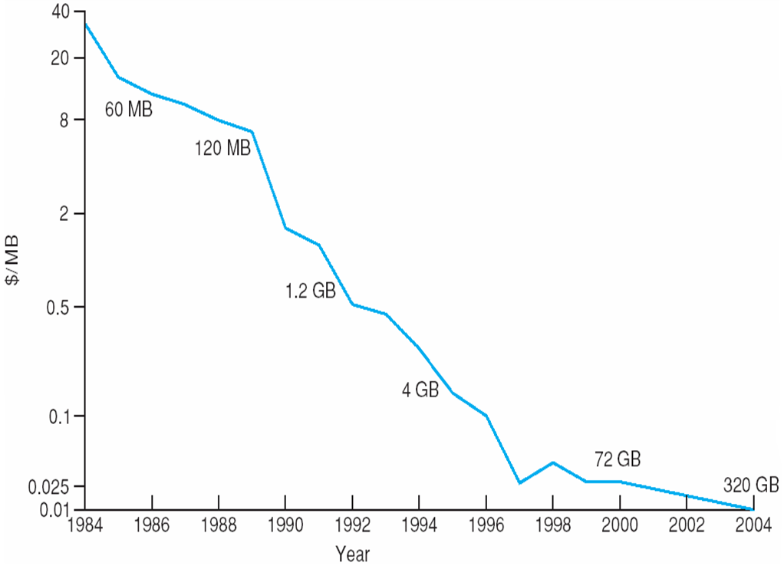
Price per Megabyte of a Tape Drive From 1984-2000

